Slide 1
College Tech Math 1A
Section 11.3
Operations on Polynomials

Slide 2
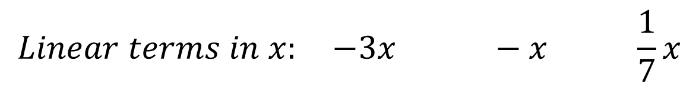
Adding/Subtracting Polynomials
Like terms – terms that have the same variables raised to the same exponents.
$$Constants: 8 −2 11 4$$
$$Linear terms in x: −3x −x \frac{1}{7}x$$
$$Linear terms in y: 4y −25y 6y$$

Slide 3
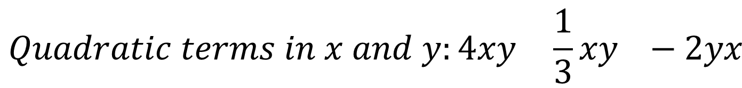
Adding/Subtracting Polynomials
$$Quadratic terms in x: 3x^{2} 5x^{2} −2x^{2}$$
$$Quadratic terms in y: −5y^{2} y^{2} 9y^{2}$$
$$Quadratic terms in x and y:4xy \frac{1}{3}xy −2yx$$

Slide 4

Adding/Subtracting Polynomials
Like terms are added or subtracted by adding or subtracting the coefficients of the terms.
$$4x^{2}+7x^{2}$$

Slide 5

Adding/Subtracting Polynomials
Like terms are added or subtracted by adding or subtracting the coefficients of the terms.
$$4x^{2}+7x^{2}$$

Slide 6

Adding/Subtracting Polynomials
Like terms are added or subtracted by adding or subtracting the coefficients of the terms.
$$4x^{2}+7x^{2}=\left(4+7\right)x^{2}$$

Slide 7

Adding/Subtracting Polynomials
Like terms are added or subtracted by adding or subtracting the coefficients of the terms.
$$4x^{2}+7x^{2}=\left(4+7\right)x^{2}=11x^{2}$$

Slide 8


Adding/Subtracting Polynomials
Like terms are added or subtracted by adding or subtracting the coefficients of the terms.
$$4x^{2}+7x^{2}=\left(4+7\right)x^{2}=11x^{2}$$
$$2xy−7xy$$

Slide 9

Adding/Subtracting Polynomials
Like terms are added or subtracted by adding or subtracting the coefficients of the terms.
$$4x^{2}+7x^{2}=\left(4+7\right)x^{2}=11x^{2}$$
$$2xy−7xy$$

Slide 10

Adding/Subtracting Polynomials
Like terms are added or subtracted by adding or subtracting the coefficients of the terms.
$$4x^{2}+7x^{2}=\left(4+7\right)x^{2}=11x^{2}$$
$$2xy−7xy=\left(2−7\right)xy$$

Slide 11
Adding/Subtracting Polynomials
Like terms are added or subtracted by adding or subtracting the coefficients of the terms.
$$4x^{2}+7x^{2}=\left(4+7\right)x^{2}=11x^{2}$$
$$2xy−7xy=\left(2−7\right)xy=−5xy$$

Slide 12

Adding/Subtracting Polynomials
Like terms are added or subtracted by adding or subtracting the coefficients of the terms.
$$4x^{2}+7x^{2}=\left(4+7\right)x^{2}=11x^{2}$$
$$2xy−7xy=\left(2−7\right)xy=−5xy$$
$$−x−4x+2x$$

Slide 13

Adding/Subtracting Polynomials
Like terms are added or subtracted by adding or subtracting the coefficients of the terms.
$$4x^{2}+7x^{2}=\left(4+7\right)x^{2}=11x^{2}$$
$$2xy−7xy=\left(2−7\right)xy=−5xy$$
$$−1x−4x+2x$$

Slide 14
Adding/Subtracting Polynomials
Like terms are added or subtracted by adding or subtracting the coefficients of the terms.
$$4x^{2}+7x^{2}=\left(4+7\right)x^{2}=11x^{2}$$
$$2xy−7xy=\left(2−7\right)xy=−5xy$$
$$−1x−4x+2x=\left(−1−4+2\right)x$$

Slide 15
Adding/Subtracting Polynomials
Like terms are added or subtracted by adding or subtracting the coefficients of the terms.
$$4x^{2}+7x^{2}=\left(4+7\right)x^{2}=11x^{2}$$
$$2xy−7xy=\left(2−7\right)xy=−5xy$$
$$−1x−4x+2x=\left(−1−4+2\right)x=−3x$$

Slide 16
Adding/Subtracting Polynomials
Simplify: $\left(3x^{2}−4x+2\right)+(−7x^{2}+x−9)$ (Example)
$$\left(3x^{2}−4x+2\right)+(−7x^{2}+x−9)$$

Slide 17


Adding/Subtracting Polynomials
Simplify: $\left(3x^{2}−4x+2\right)+(−7x^{2}+x−9)$ (Example)
$$\left(3x^{2}−4x+2\right)+(−7x^{2}+x−9)$$
$$−4x^{2}$$

Slide 18

Adding/Subtracting Polynomials
Simplify: $\left(3x^{2}−4x+2\right)+(−7x^{2}+x−9)$ (Example)
$$\left(3x^{2}−4x+2\right)+(−7x^{2}+x−9)$$
$$−4x^{2}−3x$$

Slide 19

Adding/Subtracting Polynomials
Simplify: $\left(3x^{2}−4x+2\right)+(−7x^{2}+x−9)$ (Example)
$$\left(3x^{2}−4x+2\right)+(−7x^{2}+x−9)$$
$$−4x^{2}−3x−7$$

Slide 20

Adding/Subtracting Polynomials
Simplify: $\left(3x^{2}−4x+2\right)+(−7x^{2}+x−9)$ (Example)
$$\left(3x^{2}−4x+2\right)+(−7x^{2}+x−9)$$
$$−4x^{2}−3x−7$$

Slide 21
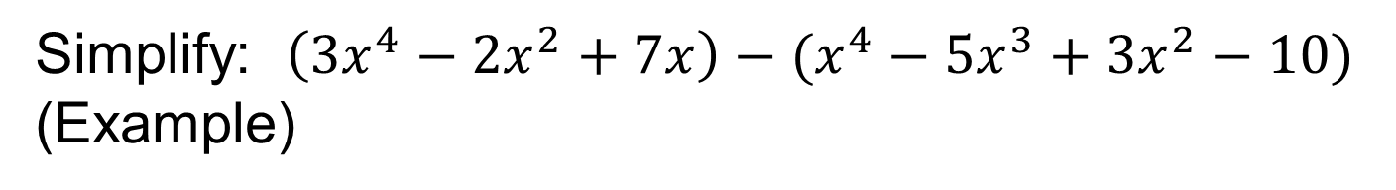
Adding/Subtracting Polynomials
Simplify: $\left(3x^{4}−2x^{2}+7x\right)−(x^{4}−5x^{3}+3x^{2}−10)$ (Example)
$$\left(3x^{4}−2x^{2}+7x\right)−(x^{4}−5x^{3}+3x^{2}−10)$$

Slide 22

Adding/Subtracting Polynomials
Simplify: $\left(3x^{4}−2x^{2}+7x\right)−(x^{4}−5x^{3}+3x^{2}−10)$ (Example)
$$\left(3x^{4}−2x^{2}+7x\right)−(x^{4}−5x^{3}+3x^{2}−10)$$
$$2x^{4}+5x^{3}−5x^{2}+7x+10$$

Slide 23

Adding/Subtracting Polynomials
Simplify: $\left(3x^{4}−2x^{2}+7x\right)−(x^{4}−5x^{3}+3x^{2}−10)$ (Example)
$$\left(3x^{4}−2x^{2}+7x\right)−(x^{4}−5x^{3}+3x^{2}−10)$$
$$2x^{4}+5x^{3}−5x^{2}+7x+10$$

Slide 24

Adding/Subtracting Polynomials
Simplify: $\left(3x^{4}−2x^{2}+7x\right)−(x^{4}−5x^{3}+3x^{2}−10)$ (Example)
$$\left(3x^{4}−2x^{2}+7x\right)−(x^{4}−5x^{3}+3x^{2}−10)$$
$$2x^{4}+5x^{3}−5x^{2}+7x+10$$

Slide 25

Adding/Subtracting Polynomials
Simplify: $\left(3x^{4}−2x^{2}+7x\right)−(x^{4}−5x^{3}+3x^{2}−10)$ (Example)
$$\left(3x^{4}−2x^{2}+7x\right)−(x^{4}−5x^{3}+3x^{2}−10)$$
$$2x^{4}+5x^{3}−5x^{2}+7x+10$$

Slide 26

Adding/Subtracting Polynomials
Simplify: $\left(3x^{4}−2x^{2}+7x\right)−(x^{4}−5x^{3}+3x^{2}−10)$ (Example)
$$\left(3x^{4}−2x^{2}+7x\right)−(x^{4}−5x^{3}+3x^{2}−10)$$
$$2x^{4}+5x^{3}−5x^{2}+7x+10$$

Slide 27

Adding/Subtracting Polynomials
Simplify: $\left(3x^{4}−2x^{2}+7x\right)−(x^{4}−5x^{3}+3x^{2}−10)$ (Example)
$$\left(3x^{4}−2x^{2}+7x\right)−(x^{4}−5x^{3}+3x^{2}−10)$$
$$2x^{4}+5x^{3}−5x^{2}+7x+10$$

Slide 28
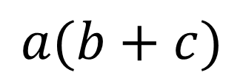
Multiplying Polynomials
All multiplications of polynomials are an application of the distributive property of multiplication over addition/subtraction.
$$a(b+c)$$

Slide 29
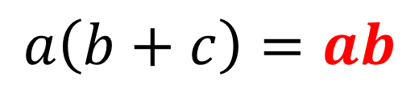
Multiplying Polynomials
All multiplications of polynomials are an application of the distributive property of multiplication over addition/subtraction.
$$a\left(b+c\right)=ab$$

Slide 30
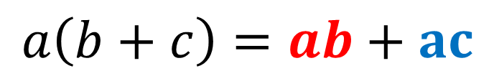
Multiplying Polynomials
All multiplications of polynomials are an application of the distributive property of multiplication over addition/subtraction.
$$a\left(b+c\right)=ab+ac$$

Slide 31
Multiplying Polynomials
All multiplications of polynomials are an application of the distributive property of multiplication over addition/subtraction.
$$a\left(b+c\right)=ab+ac$$
We will start with multiplying by a monomial

Slide 32

Multiplying Polynomials
Simplify: $2x(x^{2}+4x−5)$ (Example)
$$2x(x^{2}+4x−5)$$

Slide 33


Multiplying Polynomials
Simplify: $2x(x^{2}+4x−5)$ (Example)
$$2x(x^{2}+4x−5)$$
$$2x^{3}+8x^{2}−10x$$

Slide 34


Multiplying Polynomials
Simplify: $2x(x^{2}+4x−5)$ (Example)
$$2x(x^{2}+4x−5)$$
$$2x^{3}+8x^{2}−10x$$

Slide 35


Multiplying Polynomials
Simplify: $2x(x^{2}+4x−5)$ (Example)
$$2x(x^{2}+4x−5)$$
$$2x^{3}+8x^{2}−10x$$

Slide 36


Multiplying Polynomials
Simplify: $2x(x^{2}+4x−5)$ (Example)
$$2x(x^{2}+4x−5)$$
$$2x^{3}+8x^{2}−10x$$

Slide 37

Multiplying Polynomials
Simplify: $−3y(2y^{4}−y+5x)$ (Example)
$$−3y(2y^{4}−y+5x)$$

Slide 38


Multiplying Polynomials
Simplify: $−3y(2y^{4}−y+5x)$ (Example)
$$−3y(2y^{4}−y+5x)$$
$$−6y^{5}+3y^{2}−15xy$$

Slide 39


Multiplying Polynomials
Simplify: $−3y(2y^{4}−y+5x)$ (Example)
$$−3y(2y^{4}−y+5x)$$
$$−6y^{5}+3y^{2}−15xy$$

Slide 40


Multiplying Polynomials
Simplify: $−3y(2y^{4}−y+5x)$ (Example)
$$−3y(2y^{4}−y+5x)$$
$$−6y^{5}+3y^{2}−15xy$$

Slide 41


Multiplying Polynomials
Simplify: $−3y(2y^{4}−y+5x)$ (Example)
$$−3y(2y^{4}−y+5x)$$
$$−6y^{5}+3y^{2}−15xy$$

Slide 42
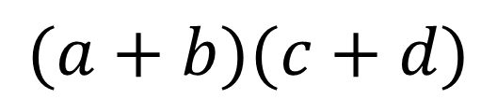
Multiplying Binomials
Multiplying two binomials uses the distributive property twice. We call this method FOIL.
$$(a+b)(c+d)$$

Slide 43
Multiplying Binomials
Multiplying two binomials uses the distributive property twice. We call this method FOIL.
$$\left(a+b\right)\left(c+d\right)=ac+ad+bc+bd$$
First

Slide 44
Multiplying Binomials
Multiplying two binomials uses the distributive property twice. We call this method FOIL.
$$\left(a+b\right)\left(c+d\right)=ac+ad+bc+bd$$
First Outside

Slide 45
Multiplying Binomials
Multiplying two binomials uses the distributive property twice. We call this method FOIL.
$$\left(a+b\right)\left(c+d\right)=ac+ad+bc+bd$$
First Outside Inside

Slide 46
Multiplying Binomials
Multiplying two binomials uses the distributive property twice. We call this method FOIL.
$$\left(a+b\right)\left(c+d\right)=ac+ad+bc+bd$$
First Outside Inside Last

Slide 47

Multiplying Binomials
Simplify: $(x−4)(x+5)$ (Example)
$$(x−4)(x+5)$$

Slide 48


Multiplying Binomials
Simplify: $(x−4)(x+5)$ (Example)
$$(x−4)(x+5)$$
First
$$x^{2}+5x−4x−20$$

Slide 49


Multiplying Binomials
Simplify: $(x−4)(x+5)$ (Example)
$$(x−4)(x+5)$$
First
$$x^{2}+5x−4x−20$$
Outside

Slide 50


Multiplying Binomials
Simplify: $(x−4)(x+5)$ (Example)
$$(x−4)(x+5)$$
First
$$x^{2}+5x−4x−20$$
Outside
Inside

Slide 51


Multiplying Binomials
Simplify: $(x−4)(x+5)$ (Example)
$$(x−4)(x+5)$$
First
$$x^{2}+5x−4x−20$$
Outside
Inside
Last

Slide 52

Multiplying Binomials
Simplify: $(x−4)(x+5)$ (Example)
$$(x−4)(x+5)$$
First
$$x^{2}+5x−4x−20$$
Outside
$$x^{2}+x−20$$
Add the like terms
Inside
Last

Slide 53

Multiplying Binomials
Simplify: $(2x+7)(x+2)$ (Example)
$$(2x+7)(x+2)$$

Slide 54


Multiplying Binomials
Simplify: $(2x+7)(x+2)$ (Example)
$$(2x+7)(x+2)$$
First
$${2x}^{2}+4x+7x+14$$

Slide 55


Multiplying Binomials
Simplify: $(2x+7)(x+2)$ (Example)
$$(2x+7)(x+2)$$
First
$${2x}^{2}+4x+7x+14$$
Outside

Slide 56


Multiplying Binomials
Simplify: $(2x+7)(x+2)$ (Example)
$$(2x+7)(x+2)$$
First
$${2x}^{2}+4x+7x+14$$
Outside
Inside

Slide 57


Multiplying Binomials
Simplify: $(2x+7)(x+2)$ (Example)
$$(2x+7)(x+2)$$
First
$${2x}^{2}+4x+7x+14$$
Outside
Inside
Last

Slide 58

Multiplying Binomials
Simplify: $(2x+7)(x+2)$ (Example)
$$(2x+7)(x+2)$$
First
$${2x}^{2}+4x+7x+14$$
Outside
$${2x}^{2}+11x+14$$
Add the like terms
Inside
Last

Slide 59
Dividing Polynomials
We will look at two different division problems with polynomials:
1) Dividing by a monomial
2) Dividing by a binomial

Slide 60
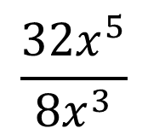
Dividing Polynomials
Simplify: $\frac{32x^{5}}{8x^{3}}$ (Example)
$$\frac{32x^{5}}{8x^{3}}$$

Slide 61

Dividing Polynomials
Simplify: $\frac{32x^{5}}{8x^{3}}$ (Example)
$$\frac{32x^{5}}{8x^{3}}=4$$

Slide 62
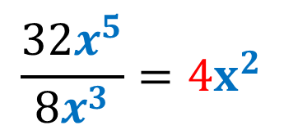
Dividing Polynomials
Simplify: $\frac{32x^{5}}{8x^{3}}$ (Example)
$$\frac{32x^{5}}{8x^{3}}=4x^{2}$$

Slide 63
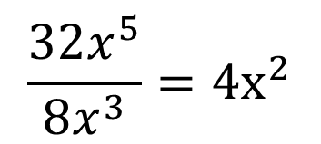
Dividing Polynomials
Simplify: $\frac{32x^{5}}{8x^{3}}$ (Example)
$$\frac{32x^{5}}{8x^{3}}=4x^{2}$$

Slide 64
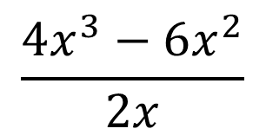
Dividing Polynomials
Simplify: $\frac{4x^{3}−6x^{2}}{2x}$ (Example)
$$\frac{4x^{3}−6x^{2}}{2x}$$

Slide 65
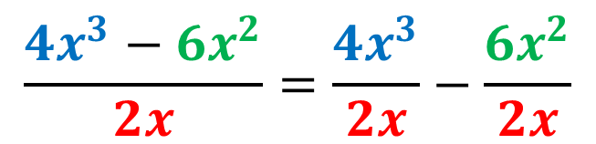
Dividing Polynomials
Simplify: $\frac{4x^{3}−6x^{2}}{2x}$ (Example)
$$\frac{4x^{3}−6x^{2}}{2x}=\frac{4x^{3}}{2x}−\frac{6x^{2}}{2x}$$

Slide 66

Dividing Polynomials
Simplify: $\frac{4x^{3}−6x^{2}}{2x}$ (Example)
$$\frac{4x^{3}−6x^{2}}{2x}=\frac{4x^{3}}{2x}−\frac{6x^{2}}{2x}$$
$$=2x^{2}−3x$$

Slide 67

Dividing Polynomials
Simplify: $\frac{4x^{3}−6x^{2}}{2x}$ (Example)
$$\frac{4x^{3}−6x^{2}}{2x}=\frac{4x^{3}}{2x}−\frac{6x^{2}}{2x}$$
$$=2x^{2}−3x$$

Slide 68

Dividing Polynomials
Simplify: $\frac{4x^{3}−6x^{2}}{2x}$ (Example)
$$\frac{4x^{3}−6x^{2}}{2x}=\frac{4x^{3}}{2x}−\frac{6x^{2}}{2x}$$
$$=2x^{2}−3x$$

Slide 69
Dividing Polynomials
The previous examples were divisions by a monomial. Dividing by a binomial requires the use of the long division algorithm.
This will be easier for me to demonstrate on the whiteboard, so I will complete the following problems on the whiteboard.

Slide 70

Dividing Polynomials
Perform the indicated division and determine if the binomial is a factor of the dividend. (Examples)
$$a) x+2 x^{3}+6x^{2}+3x−10$$
$$b) x−4 x^{3}−10x^{2}+14x−8$$
$$c) x+2 x^{4}−3x+2$$

